Slide 1
Hypothesis testing and null models
A unified theory of Golem engineering
Dr. Gregor Mathes

Slide 2

The Golem of Prague
built from dust, fire and water
extremely powerful but naive
does exactly what it is told
careless instructions can turn a Golem against its maker
Notes:
A golem (goh-lem) is a clay robot known in Jewish folklore, constructed from dust and fire and water. It is brought to life by inscribing emet, Hebrew for “truth,” on its brow. Animated by truth, but lacking free will, a golem always does exactly what it is told. This is lucky, because the golem is incredibly powerful, able to withstand and accomplish more than its creators could. However, its obedience also brings danger, as careless instructions or unexpected events can turn a golem against its makers. Its abundance of power is matched by its lack of wisdom

Slide 3
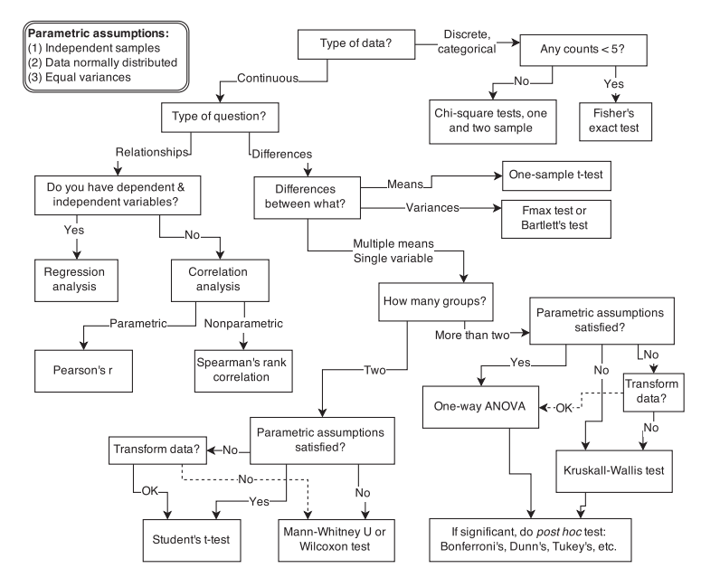
The Golem of Prague
Scientists also make Golems - scientific models¹
Models completely follow instructions
Premanufactured models are inflexible and fragile
Limited ways to adapt to unique research contexts and prone to fail when applied to new contexts
Applying a model without detailed knowledge of its purpose can break havoc
and it won’t even tell you that
1 Collins and Pinch (1998)

Slide 4
Why are we building models?
Data exploration
Purpose: Detect patterns, generate hypotheses, describe variation
Limits: Vulnerable to biased data
Prediction
Purpose: Forecast future states or unobserved condition
Limits: Confounding variables or extrapolation beyond observed data can lead to unreliable forecast
Causal understanding
Purpose: Test mechanistic hypotheses
Limits: Causality can be obscured by unmeasured variables and correlations that don’t reflect true mechanisms

Slide 5
The concept of model engineering
Main purpose is to understand the world around us
The world is overwhelmingly complex, rendering understanding impossible
Models are a simplified version of our world
The simplifications we make are the assumptions built into the model
Choosing what to include (and exclude) are powerful assumptions that make real world problems manageable
All models are wrong, but some are useful
Notes:
Choosing which variables to include (and exclude), deciding on a mathematical relationship (e.g., linear), and selecting a probability distribution are all powerful assumptions that make the problem manageable. Our Golem is not the real world and is guaranteed to be "wrong." But by observing how this simplified Golem behaves and how well it explains our data, we learn something valuable about the real world.

Slide 6
What is a good model?
A formal statement of a scientific hypothesis
tailored to unique research contexts
With memory to transfer information across systems
Able to make accurate predictions for unseen data
Produces output that can be tested against empirical evidence
Is parsimonious
Uses the minimum number of parameters necessary to tell its generative story and make good predictions
Acknowledges uncertainty
Provides a full range of plausible values and carries uncertainty through to its predictions
With transparent assumptions so that the merit of the model can be judged by peers

Slide 7

Linear regression
Fisher’s test
t-test
ANOVA
Spearman’s rank
Bartlett’s test
Linear regression
Pearson’s r
Chi-squared test
Fmax test
The swiss army knife of statistical models³
Wilcoxon test
Kruskal-Wallis
3 lindeloev.github.io/tests-as-linear/

Slide 8
Linear regression
simple statistical Golems that attempt to learn about the mean and variance of some measurement
describe a very large variety of natural phenomena
descriptive models that correspond to many different process models
Assumptions often not met in real life
complex models are often better suited
but normally best starting point
once you understand linear regression, you can more easily move on to other types of regression which are less normal

Slide 9
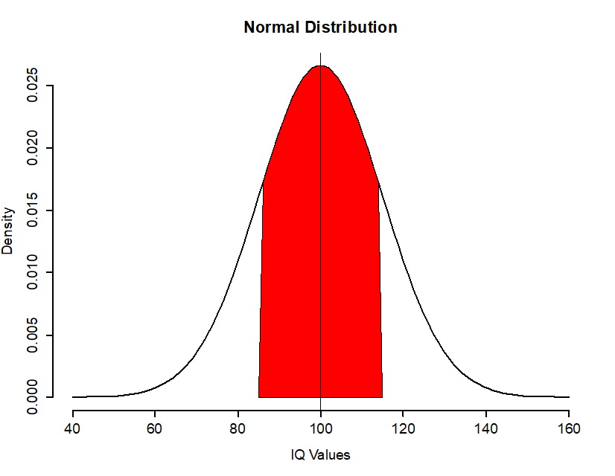
Linear regression
ordinary linear models assume that the outcome is normally-distributed
many real-life phenomena are normally-distributed (hence the name)
this is often a good starting point when all we can say about a distribution is that values are distributed across a mean with a given standard deviation

Slide 10
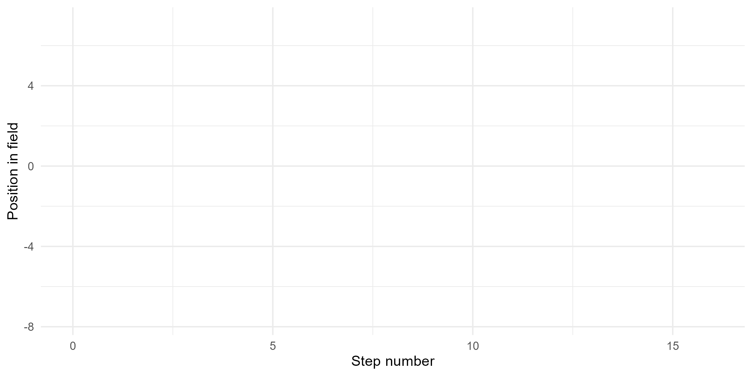
Normal by addition

Slide 11
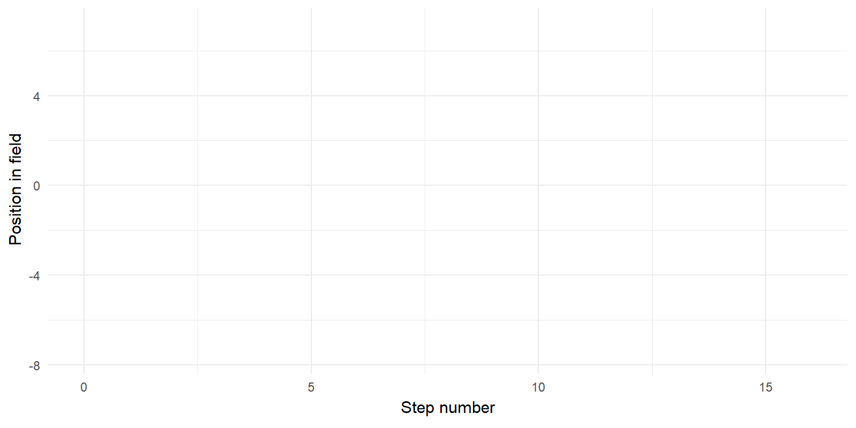
Normal by addition

Slide 12
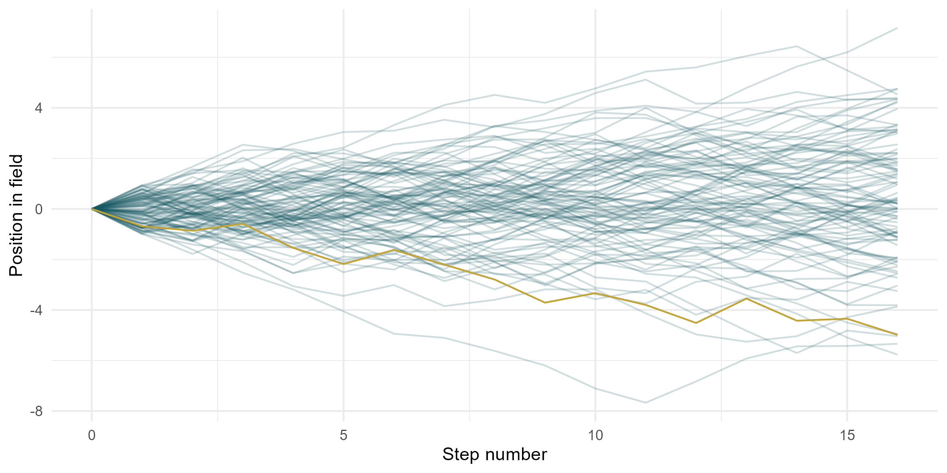
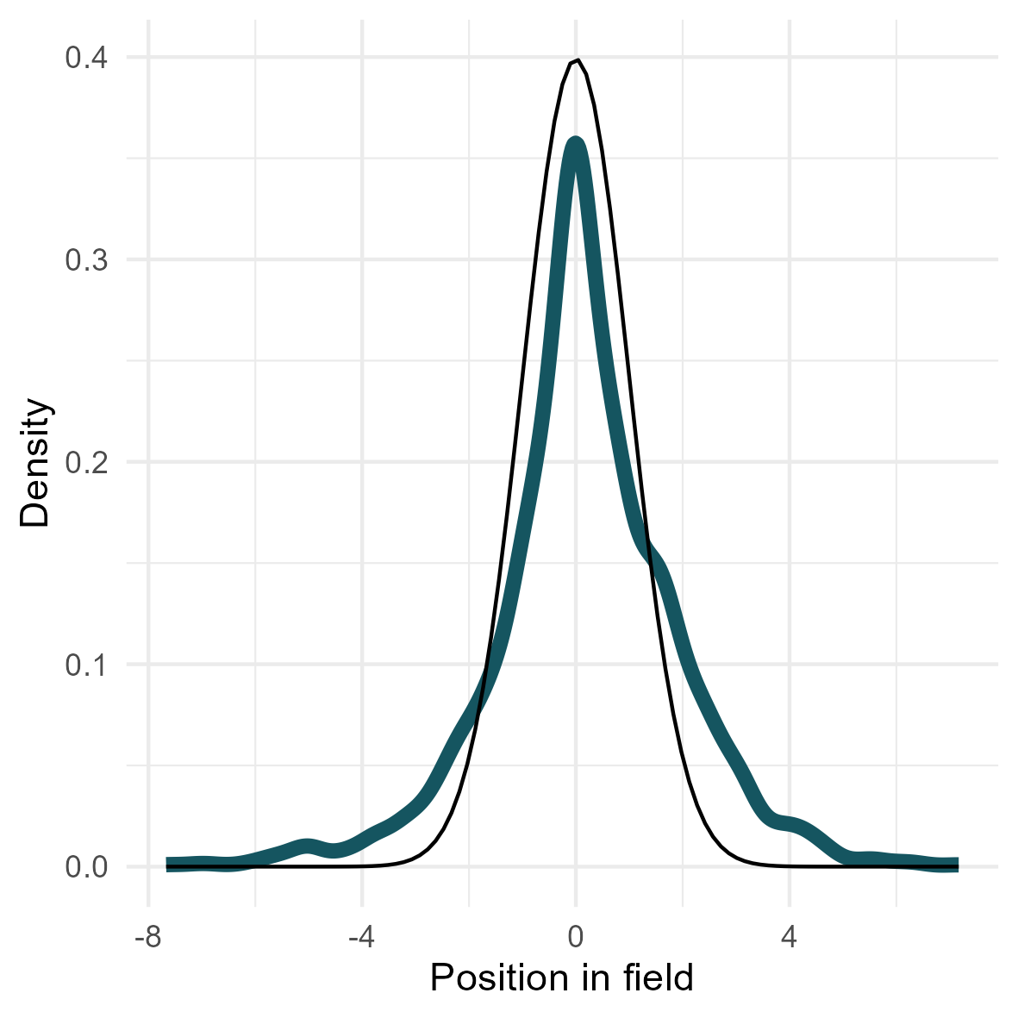
Normal by addition
+ normal by multiplication of small deviates
+ log-normal by multiplication of large deviates

Slide 13
Assumptions of linear models
Data-process is normally distributed → Homoscedasticity
Linearity → relationship between variables is a straight line
Independence of observations

Slide 14
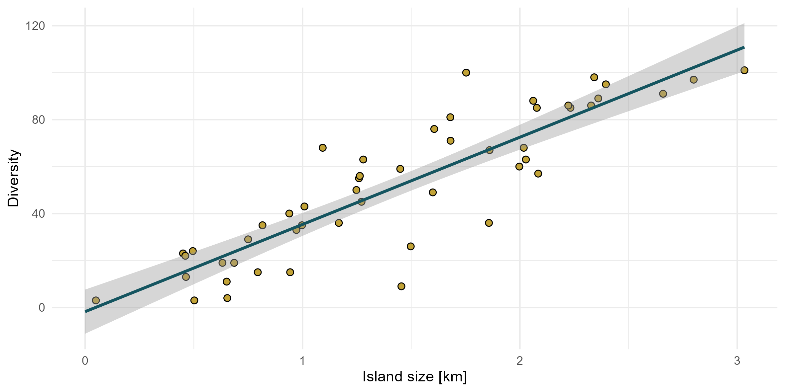
Linear regression
when we fit a regression model in the form outcome ~ exposure, we will get an intercept and a slope
the intercept is the mean of the outcome when the exposure is zero

Slide 15
Linear regression
when we fit a regression model in the form outcome ~ exposure, we will get an intercept and a slope
the slope describes the change in the outcome with each unit change in the exposure

Slide 16
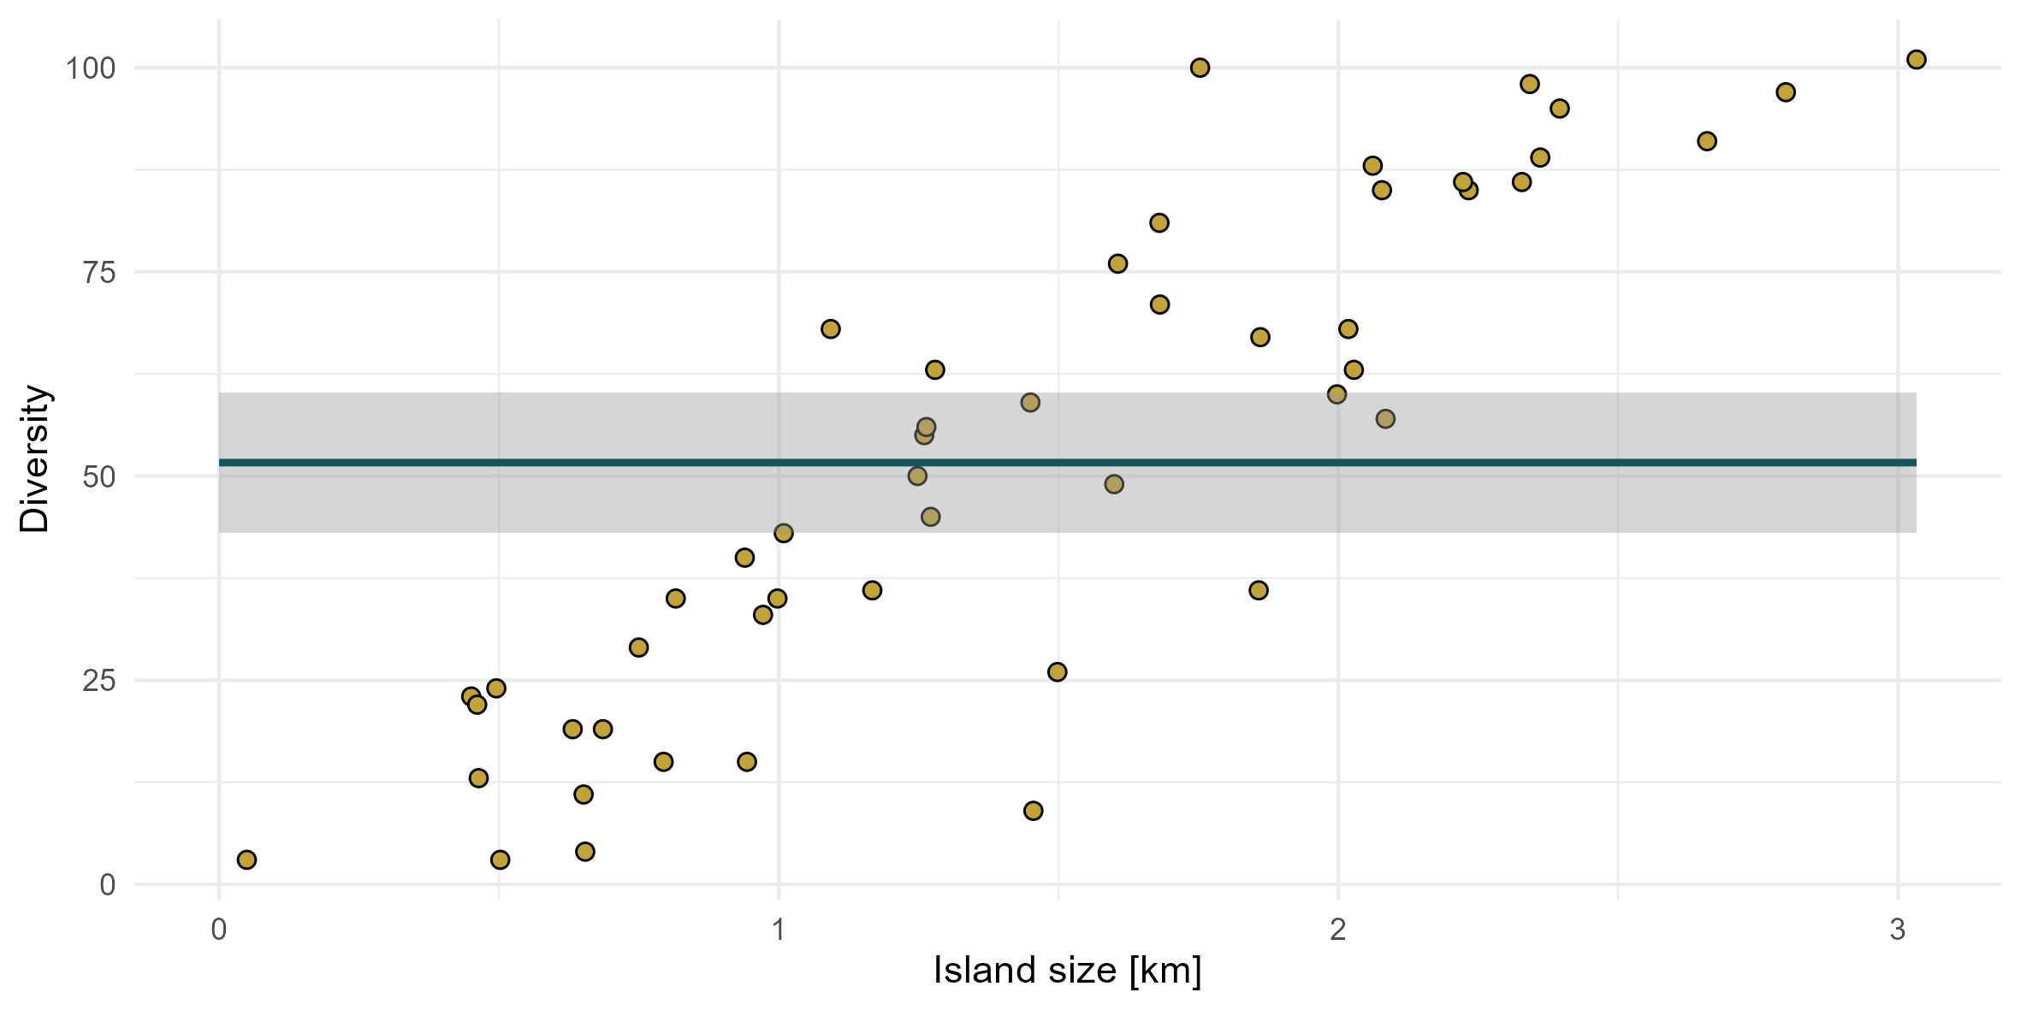
Linear regression
we can estimate the average (i.e., mean outcome) when we only use the intercept in the form outcome ~ 1

Slide 17
Exercise 1 – Linear regression
Go through the 1_exercise_lm.R script in the Github repository sample_standardisation

Slide 18

Null hypothesis testing
You can't negotiate with a zombie

Slide 19
Null hypothesis testing
The Premise: We build models (Golems) that represent plausible hypotheses about how the world works
we have a research hypothesis (e.g. diversity increases with island size) and we build a model to embody this idea
The Problem: How good is our model?
What if the predictor variable has zero effect on the outcome, and the pattern our model found is just random noise?
The Solution: We can build a brainless Zombie Golem
The Zombie thinks that everything was created by random chance
We can show them the actual data and see how surprised they react
If they are surprised, we conclude that our data was not created by random chance alone

Slide 20
Null hypothesis testing
Hypothesis testing is a statistical method to make inferences about population parameters based on sample data
Null Hypothesis (H0): No effect or difference
Alternative Hypothesis (H1): There is an effect or difference
Goal: Determine whether to reject H0 based on sample data

Slide 21
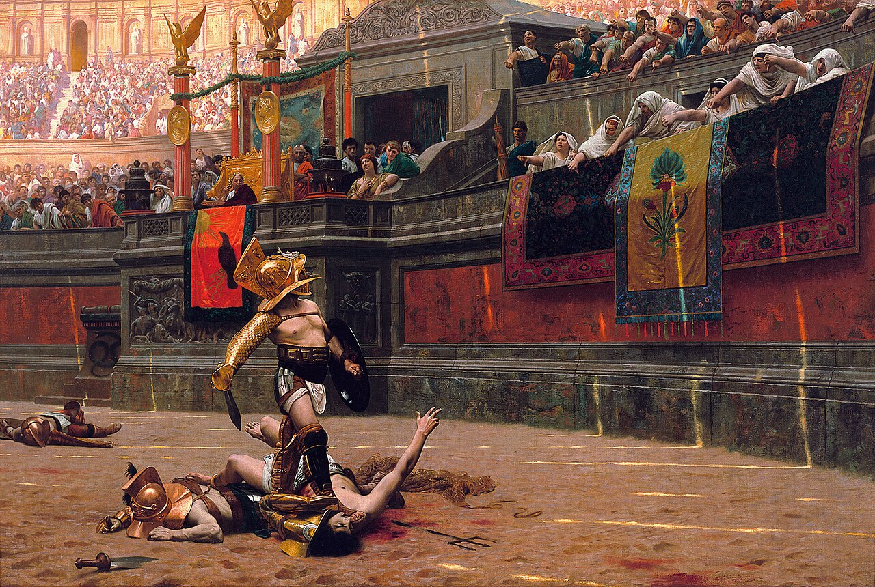
Null hypothesis testing
State the Hypotheses:
H0: Population mean = some value
H1: Population mean ≠ some value
Choose the Significance Level (α):
Commonly set at 0.05
Collect Data:
Obtain sample data
Calculate the Test Statistic:
Use appropriate models or statistics
Make a Decision:
Compare the p-value with α
We can do much better than that…

Slide 22
Null hypothesis testing
in its simplest form, NHST assumes that any effect > 0 is significant

Slide 23
Permutation
The null hypothesis of "exactly zero effect" is a strawman
In complex systems, everything has some effect, even if it's trivially small
We need to improve our Zombie by incorporation more information about the real world
We can build a model that mimics the properties of our real world but where the effect is zero
We can do so by permutation–reshuffling our empirical data, thereby breaking apart the relationship/ effect but keeping all other contributes of our data

Slide 24
Permutation
Island | Diversity | Size
1 | 50 | 0.2
2 | 60 | 0.4
3 | 70 | 0.6
4 | 80 | 0.7

Slide 25
Permutation
Island | Diversity | Size | Size shuffled
1 | 50 | 0.2 | 0.4
2 | 60 | 0.4 | 0.7
3 | 70 | 0.6 | 0.2
4 | 80 | 0.7 | 0.6

Slide 26
Permutation
Island | Diversity | Size | Size shuffled | Size shuffled
1 | 50 | 0.2 | 0.4 | 0.2
2 | 60 | 0.4 | 0.7 | 0.6
3 | 70 | 0.6 | 0.2 | 0.7
4 | 80 | 0.7 | 0.6 | 0.4

Slide 27
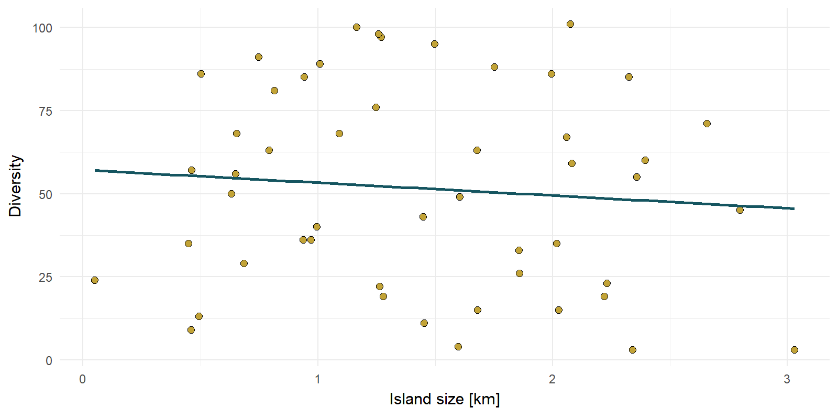
Permutation

Slide 28
Exercise 2 – Let‘s build a Zombie
restart your R-session
Open the 2_exercise_permutation.file from your files viewer in RStudio
What is your judgement? Is the null hypothesis true?

Slide 29
NHST criticism

Slide 30
NHST criticism
NHST answers the wrong question
We don't want to know the probability of the data given the null hypothesis (p-value)
We want to know the plausibility of our hypothesis given the data
The Null is almost always false
In complex systems, everything has some effect, even if it's trivially small
With enough data, everything is significant
It is arbitrary
An alpha of 0.05 creates a false dichotomy
A p-value of 0.049 is deemed a "discovery" while 0.051 is a "failure," which is absurd
It provides no information
Rejecting the null Golem tells you nothing about the plausibility or magnitude of your own, more interesting Golem
It just tells you that the zombie Golem is likely wrong

Slide 31
Model comparison
Let the Golems fight

Slide 32
Model comparison
Science is not about surprising a zombie, it’s about weighing competing ideas
Instead of one dumb Golem, we build several, each one representing a different plausible idea about how the world works
Instead of asking one if it's surprised, we give all our Golems the same data and ask: "Which of you provides the best explanation for what we saw?"

Slide 33
Model comparison
We need to account for complexity, because a more complex Golem will always fit better
Principle of parsimony recommends searching for explanations constructed with the smallest possible set of elements
When presented with competing hypotheses about the same prediction and both hypotheses have equal explanatory power, one should prefer the hypothesis that requires the fewest assumptions

Slide 34
Model comparison
Akaike’s information criterion
AIC is founded on information theory
A statistical model is used to represent the process that generated the data
some information will be lost by using the model to represent the process
AIC estimates the relative amount of information lost by a given model
the less information a model loses, the higher the quality of that model - the lower the AIC, the better the model
By incorporating parsimony, AIC deals with the trade-off between the goodness of fit of the model and the simplicity of the model

Slide 35
Model comparison
we want to specify competing Golems and find the best performing out of these by means of AIC
Before we can do this, we need to expand our abilities to define models/ build Golems

Slide 36

Generalized models
Expanding your toolset of Golem engineering

Slide 37
GLMs
While the normal-distribution occurs frequently, a lot of processes can be better approximated by non-normal distributions
Diversity is a metric counting how many species occur in a given space
Bound at zero and potentially unlimited
Insufficient to describe
solely by mean and variation

Slide 38
GLMs
Most important distributions
Poisson: Count data
Binomial (logistic regression): Binary outcome
Student-T (robust regression): Normal outcome with outliers
Categorical: Multiple categorical outcomes
Beta: Bound between 0-1 (proportions, rates…)

Slide 39
GLMs
you can fit a model in R using the glm() function instead of the lm() function
similar to lm, you will need a formula: outcome ~ exposure + covariables
you also need to provide the dataset (data = my_data_variable)
but you also need to specify the family of the outcome: glm(duration ~ exposure, family = “poisson”)

Slide 40
Link functions
To connect the linear predictor to the mean of the response variable, Glm’s require a link function
In other words, GLMs are linear models in disguise
GLMs first transform our data until it is normally distributed via a link function
They then fit a straight line through these transformed values
when we query these models, they will provide us only with the transformed values
we need to retransform these values via the inverse of the provided link function
Coefficients are transformed and you need to retransform them first

Slide 41
Exercise 3 – Let the Golems fight
restart your R-session
Open the 3_exercise_aic.R file from your files viewer in RStudio
What is your judgement? What is the best performing model? Can you think of ways to further improve that model?

Slide 42
Summary
We build simplified models ("Golems") as tools to help us think about a complex world
they are always wrong, but some are useful
The null hypothesis is simply our most naive model—a "zombie Golem" built on the assumption of "no relationship"—that we use as a baseline for comparison
Hypothesis testing is better understood as model comparison
we weigh the evidence for our scientific model against the evidence for the null model to see which provides a better explanation for the data
Techniques like permutation tests are powerful because they let us physically simulate the "null world“
giving us an intuitive benchmark to compare our real-world results against
This framework extends to all modeling: GLMs, for example, are flexible Golems that relate a simple, linear core to messy, real-world data using a link function as a translator

